Slide 1

MICROBIT
BASICS

Slide 2
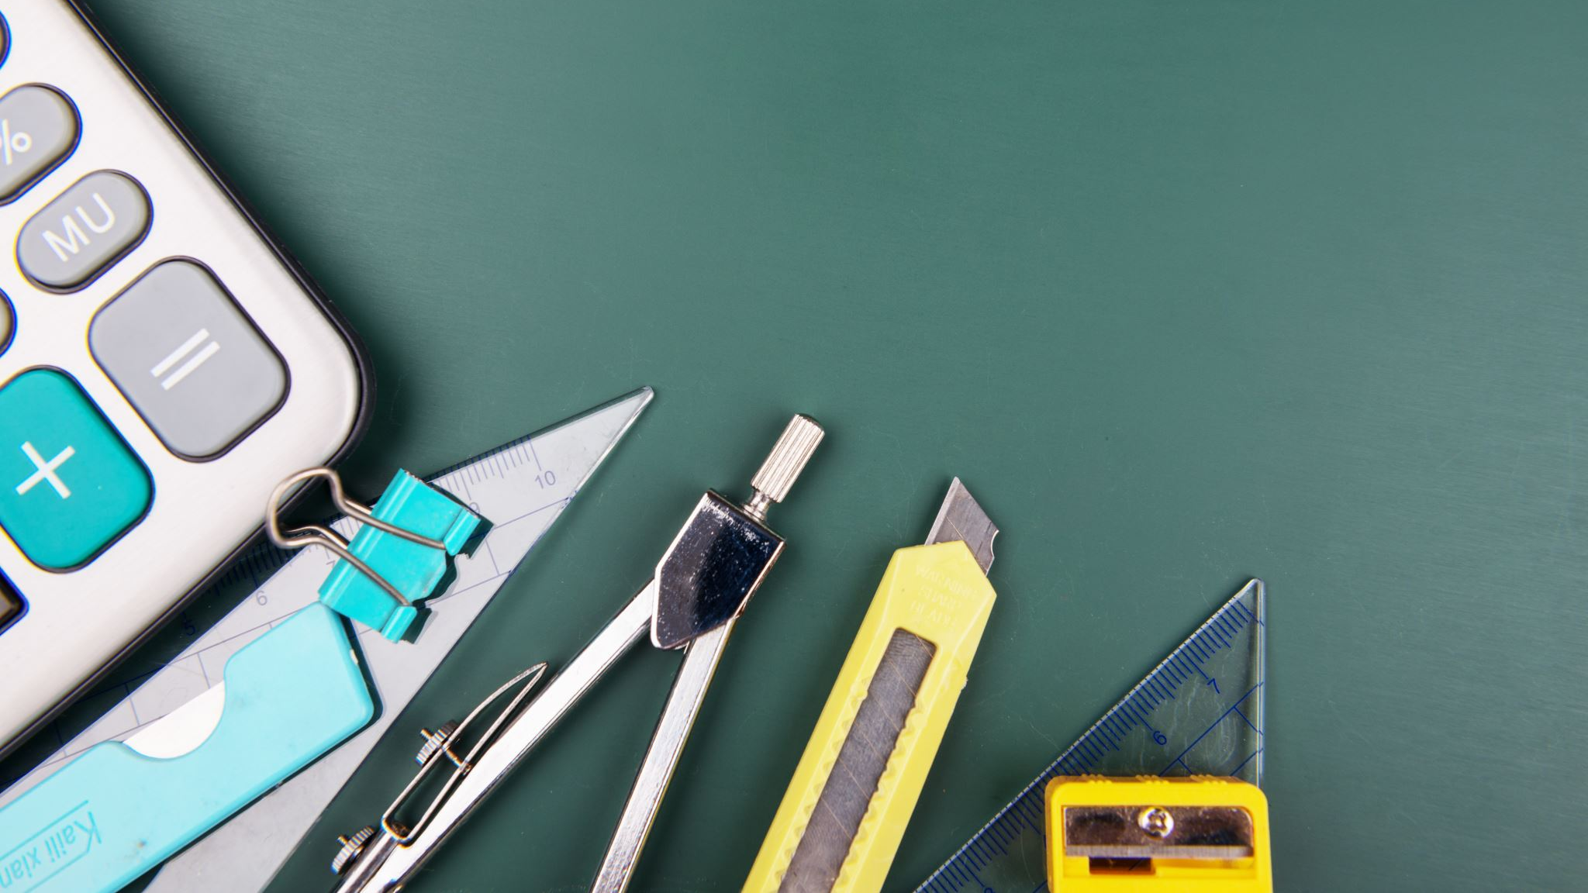
BASICS

Slide 3
ABOUT THE BBC MICROBIT
The BBC MICROBIT is a small programing board that allows young learners to build amazing things like robots,tools and many more amazing things.

Slide 4
Versions of BBC MICROBIT
There are two Versions of the BBC MICROBIT. BBC MICROBIT. BBC MICROBIT. BBC MICROBIT and BBC MICROBIT V2 . The BBC MICROBIT doesn’t have inbuilt speaker and the V2 versions has an inbuilt speaker. ersions of BBC MICROBIT Versions of BBC MICROBIT

Slide 5
HOW TO CODE THE BBC MICROBIT
You can code the BBC MICROBIT with Microsoft codeediter,scrath and some python editers.

